Slide 1
OMOP Common Data Model and Standardized Vocabularies
15- September-2019
Christian Reich, MD, PhD, Mui van Zandt
Erica A. Voss, MPH, PMP, Hamed Abedtash, PharmD, PhD
Dmitry Dymshyts, MD, Melanie Philofsky, RN, MS
Don Torok, MS

Slide 2
After the Tutorials, you will know…
History of OMOP, OHDSI
How the Standardized Vocabulary works
How to find codes and Concepts
How to navigate the concept hierarchy
The OMOP Common Data Model (CDM)
How to use the OMOP CDM

Slide 3
Agenda
Section | Speaker | Time | Item(s)
Registration | - | 8:00- 9:00 (1 hour)
Introduction | Christian | 9:00 - 10:00 (1 hour) | Introductions and Ground Rules Foundational History of OMOP Why and How Birth of OHDSI Introduction to OMOP Common Data Model OHDSI Community Example of Remote Study VM Overview
Vocabulary – Part 1 | Hamed | 10:00 – 10:30 (30 min) | Basic Relationship
Break | - | 10:30 - 10:45 (15 min)
Vocabulary – Part 2 | Dima | 10:45- 12:30 (1 hour & 45 min) | Ancestors & Descendants How does it work for Drugs SQL Examples

Slide 4
Agenda (cont.)
Section | Speaker | Time | Item(s)
Lunch | - | 12:30 - 13:30 (1 hour) | -
Vocabulary – Part 3 | Melanie | 13:30 - 14:00 (30 min) | Continued
Common Data Model | Don | 14:00 - 15:35 (1 hour & 30 min) | History of the model In depth discussion of model Era discussion Real World Scenario ETL Pitfalls
Break | - | 15:30 - 15:45 (15 min) | -
CDM Examples | Mui / Erica | 15:45 - 17:00 (1 hour & 16 min) | Leveraging OHDSI Tools (GitHub/Forums/Working Group) Exercises OHDSI Community Conclusion Game

Slide 5






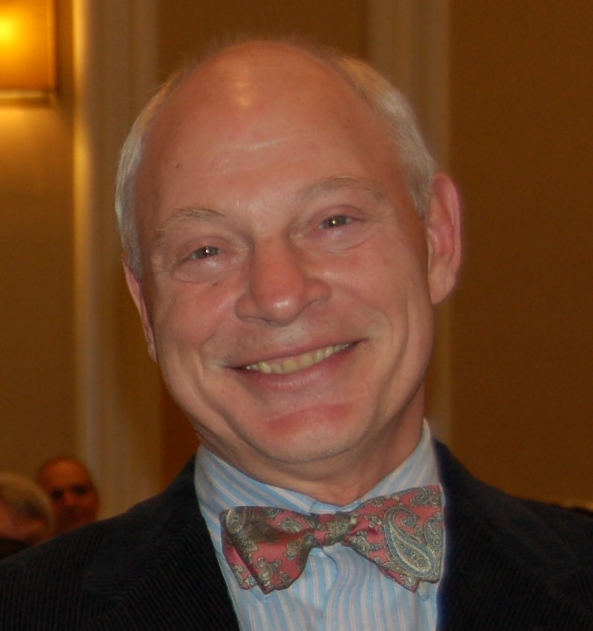
Instructors
Christian Reich, MD, PhD | Mui van Zandt | Erica A. Voss, MPH, PMP | Hamed Abedtash, PharmD, PhD
Dmitry Dymshyts, MD | Melanie Philofsky, RN, MS | Don Torok, MS

Slide 6

Ground Rules
We are recording today’s session.
We may table some questions if they are too specific.
If we cannot get the remote desktop working on your machine let’s try to buddy you up. Do not worry the presentation will still walk you through the content.

Slide 7
Foundational
What is OMOP/OHDSI? OMOP Common Data Model (CDM) – Why and How

Slide 8

FDA Regulatory Action over Time

Slide 9
FDAAA calls for establishing Risk Identification and Analysis System
Risk Identification and Analysis System:
a systematic and reproducible process to efficiently generate evidence to support the characterization of the potential effects of medical products from across a network of disparate observational healthcare data sources

Slide 10
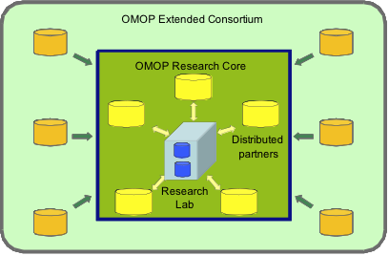
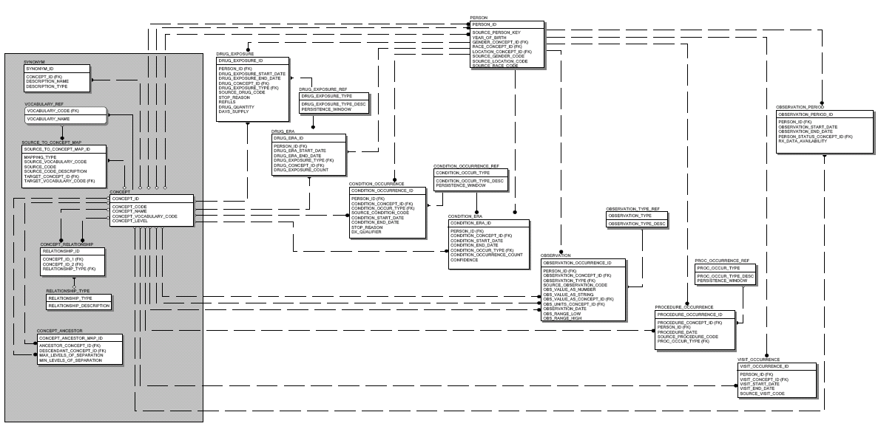
OMOP Experiment 1 (2009-2010)
Open-source
Standards-based
OMOP Methods Library
Inception cohort
Case control
Logistic regression
Common Data Model
10 data sources
Claims and EHRs
200M+ lives
14 methods
Epidemiology designs
Statistical approaches adapted for longitudinal data

Slide 11

OMOP Experiment 2 (2011-2012)
Observational Data
Methods
Case-Control
New User Cohort
Disproportionality methods
ICTPD
LGPS
Self-Controlled Cohort
SCCS
4 claims databases
1 ambulatory EMR
Drug-outcome pairs

Slide 12




European OMOP Experiment
Observational Data
Methods
Case-Control
New User Cohort
Disproportionality methods
ICTPD
LGPS
Self-Controlled Cohort
SCCS
ARS
IPCI
HS
PHARMO
Drug-outcome pairs

Slide 13
Ground Truth for OMOP Experiment
isoniazid
fluticasone
indomethacin
clindamycin
ibuprofen
pioglitazone
loratadine
sertraline
Criteria for positive controls:
Event listed in Boxed Warning or Warnings/Precautions section of active FDA structured product label
Drug listed as ‘causative agent’ in Tisdale et al, 2010: Drug-Induced Diseases
Literature review identified no powered studies with refuting evidence of effect
Criteria for negative controls:
Event not listed anywhere in any section of active FDA structured product label
Drug not listed as ‘causative agent’ in Tisdale et al, 2010: Drug-Induced Diseases
Literature review identified no powered studies with evidence of potential positive association

Slide 14
Results

Slide 15
Main findings in OMOP experiment
Heterogeneity in estimates due to choice of database
Heterogeneity in estimates due to analysis choices
Except little heterogeneity due to outcome definitions
Good performance (AUC > 0.7) in distinguishing positive from negative controls for optimal methods when stratifying by outcome and restricting to powered test cases
Self controlled methods perform best for all outcomes

Slide 16
Observational Health Data Sciences and Informatics (OHDSI) Plans and Ambitions

Slide 17



Fate of OMOP - OHDSI
OHDSI
Columbia University
OMOP Investigators
The Observational Health Data Sciences and Informatics (OHDSI) program is a multi-stakeholder, interdisciplinary collaborative to create open-source solutions that bring out the value of observational health data through large-scale analytics
OHDSI has established an international network of researchers and observational health databases with a central coordinating center housed at Columbia University
Public, Open
Not Pharma-funded
International
http://ohdsi.org

Slide 18
OHDSI’s Mission & Vision
To improve health by empowering a community to collaboratively generate the evidence that promotes better health decisions and better care.
A world in which observational research produces a comprehensive understanding of health and disease.
Join us on the journey
http://ohdsi.org

Slide 19
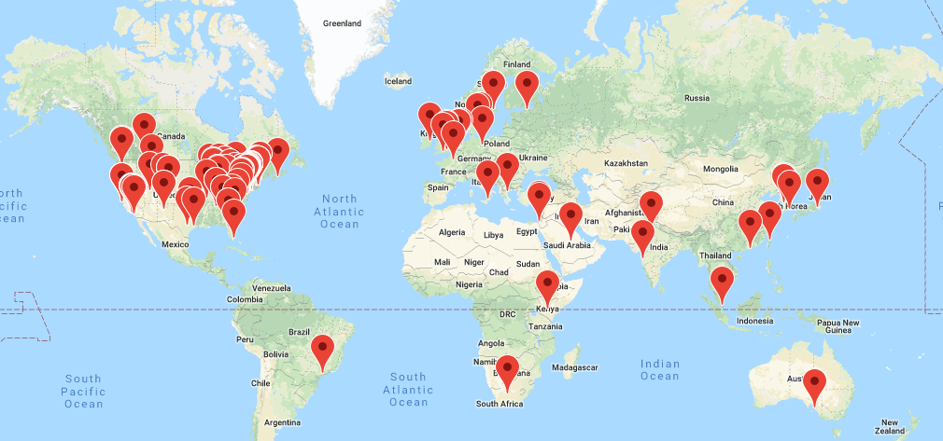
OHDSI: a global community
OHDSI Collaborators:
>220 researchers in academia, industry and government
>21 countries
OHDSI Data Network:
>114 databases from 19 countries
1.9 billion patients records (duplicates)
~222 million non-US patients

Slide 20
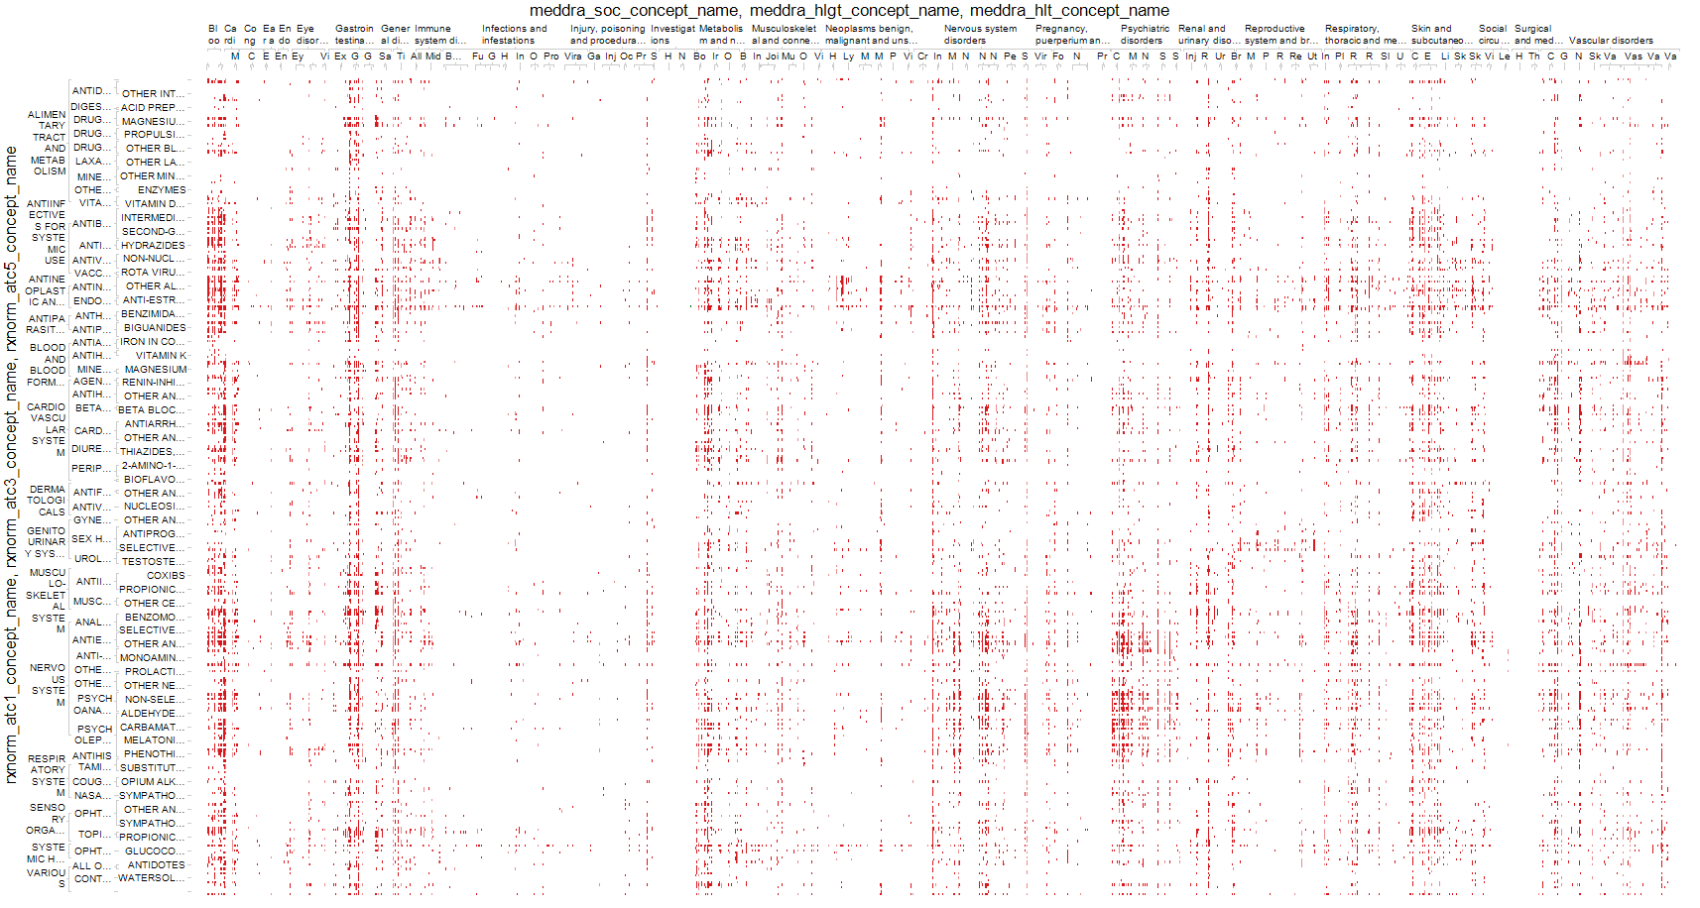
Current pace of evidence generation in healthcare
All health outcomes of interest
All drugs

Slide 21
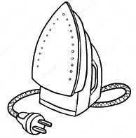
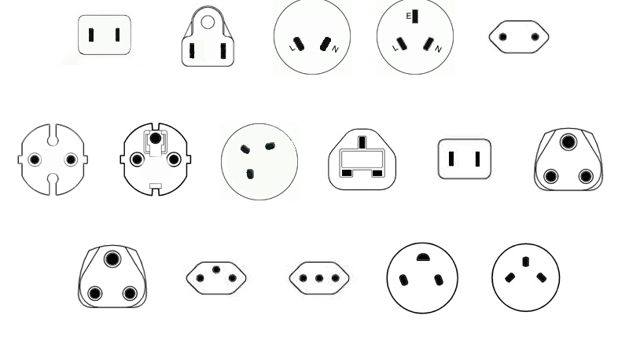
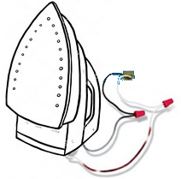
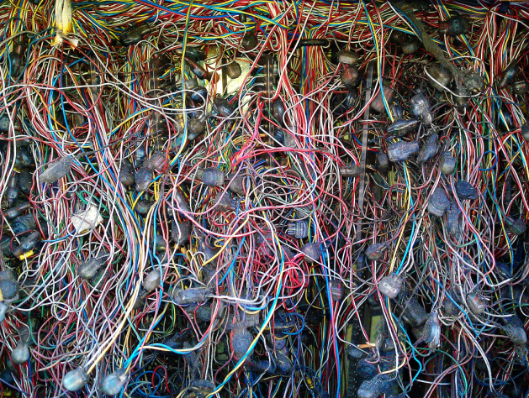
Current Approach: “One Study – One Script“
"What's the adherence to my drug in the data assets I own?"
Current solution:
Analytical method: Adherence to Drug
North America
Southeast Asia
China
Europe
UK
Japan
India
Application to data
Switzerland
Italy
So Africa
Israel
Not scalable
Not transparent
Expensive
Slow
Prohibitive to non-expert routine use
One SAS or R script for each study

Slide 22



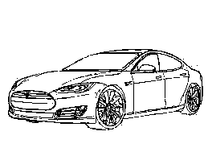
Solution: Data Standardization Enables Systematic Research
Adherence
Mortality
Source of Business
North America Southeast Asia China
Europe UK Japan India
So Africa Switzerland Italy Israel
Safety Signals
Standardized data
OHDSI Tools OMOP CDM

Slide 23


Analytics can be remote
North America Southeast Asia China
Europe UK Japan India
So Africa Switzerland Italy Israel

Slide 24
Analytics can be behind firewall

Slide 25

Network Studies Networks of networks
EMR
EMR
EMR
University Medical Center
EMR
ISDN
Inpatient Hospital
Claims Asset
Coordinating
Center
Outpatient Hospital
Claims Asset
EMR Asset
Coordinating Center
Another Network
Network
Claims Asset
Claims Asset
Claims Asset
EMR Asset
EMR Asset
EMR Asset
EMR Asset

Slide 26
Virtual Machine

Slide 27






OHDSI in a Box
Raw Lauren
PostgreSQL
CDM Lauren (EMPTY)
cdm
webapi
Atlas
Raw Synthea
WebTools
WebAPI
CDM Synthea
PGAdmin4
Tomcat
CDM Synpuf (100K)
Methods Library
WhiteRabbit
OHDSI R packages
Studio
Usagi

Slide 28

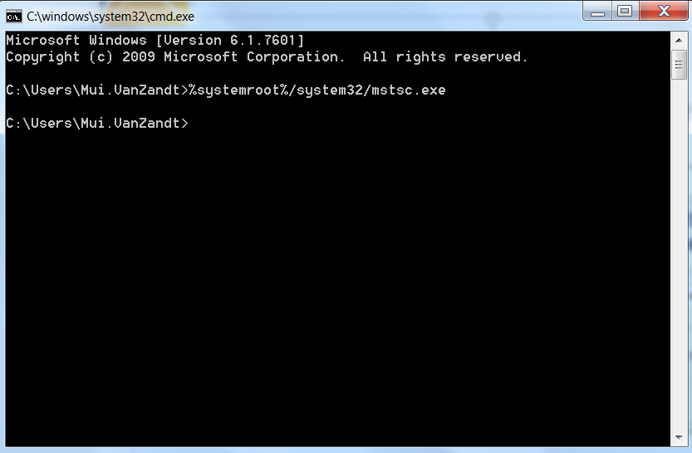
How to Sign into the Remote Desktop
From your command prompt, type %systemroot%/system32/mstsc.exe to launch Remote Desktop

Slide 29
How to Sign into the Remote Desktop
Use the shortcut on the desktop named “Remote Desktop”
UPDATED LATER
Pick one of the rows and put your name on the second column

Slide 30
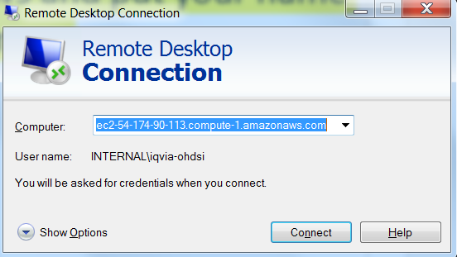
How to Sign into the Remote Desktop
Take Column A from spreadsheet and copy into the “Computer” field

Slide 31
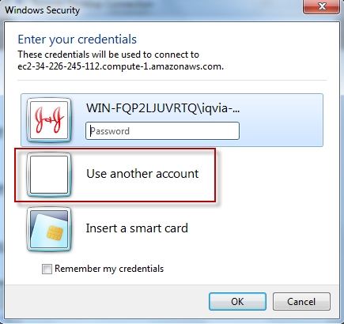
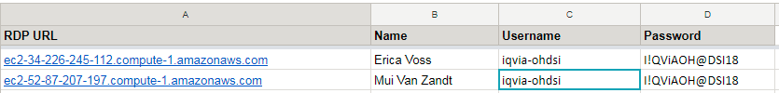
How to Sign into the Remote Desktop
Pick ‘Use Another Account’
Copy username from Column C
Copy password from Column D

Slide 32
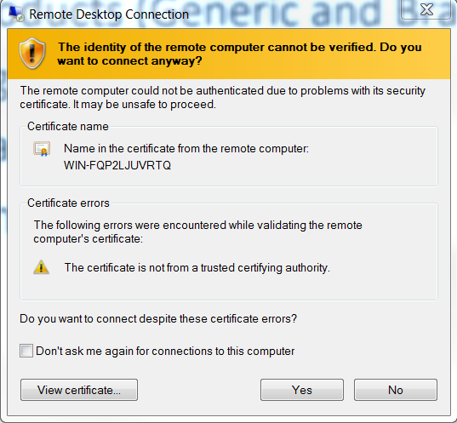
How to Sign into the Remote Desktop
If you get this page, select “Yes”

Slide 33
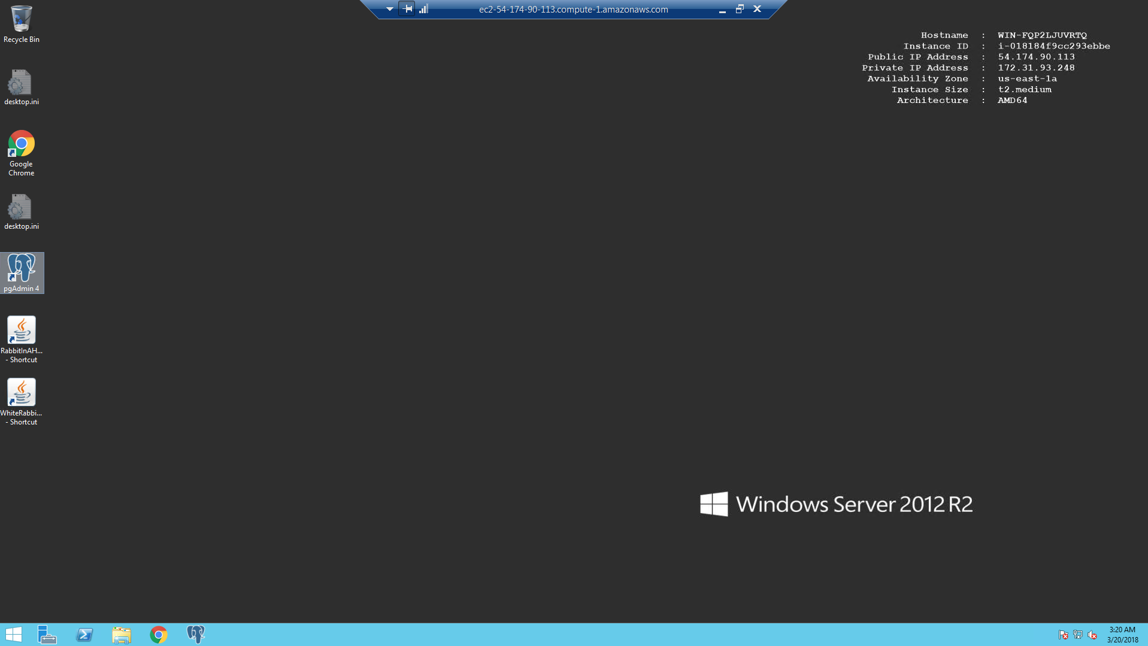
OHDSI in a Box – Ready

Slide 34

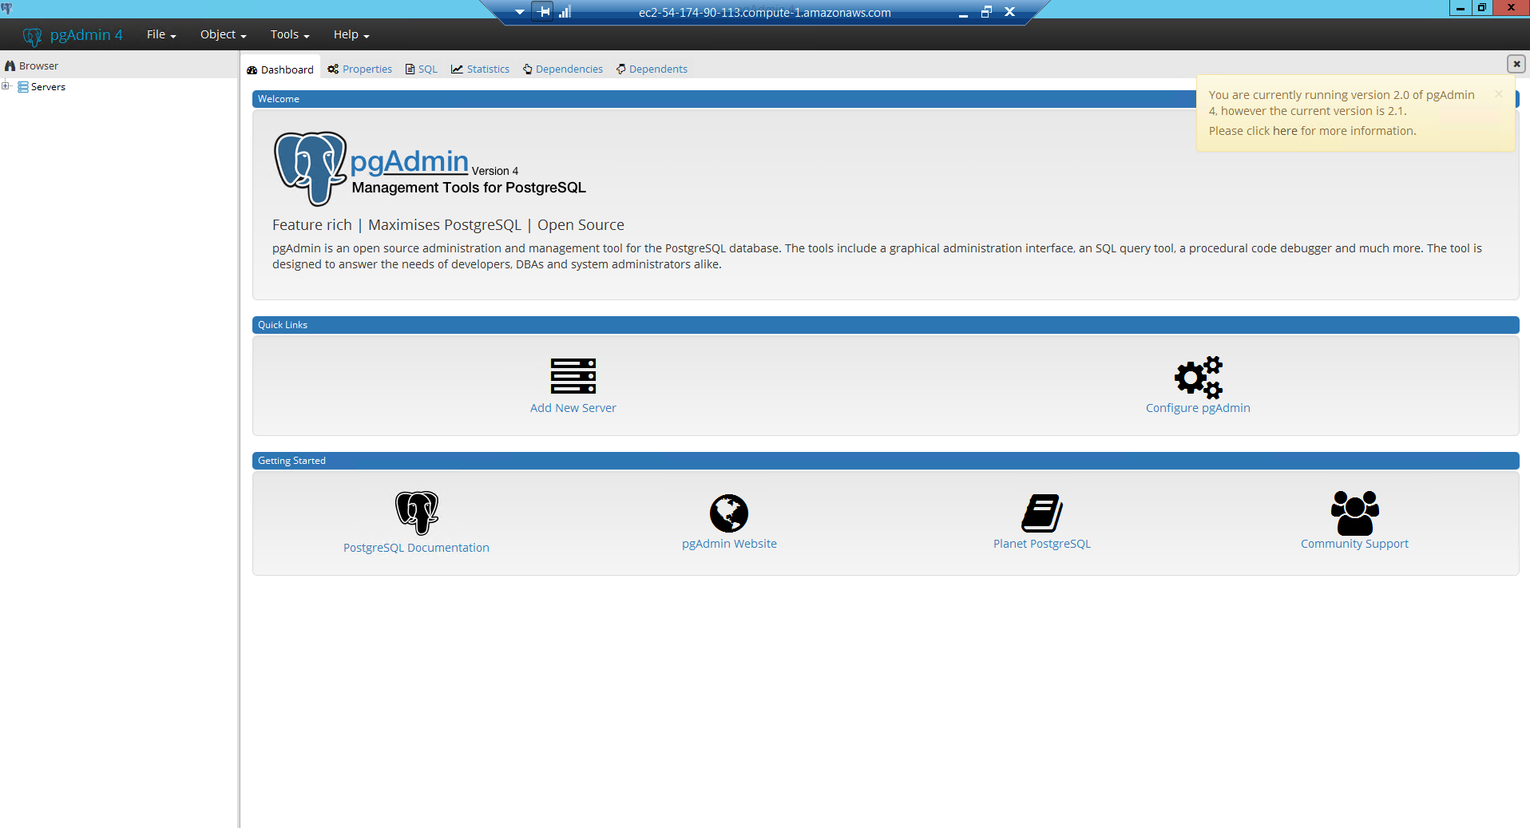
CDM Database: pgAdmin III New Server
Click on pgAdmin

Slide 35
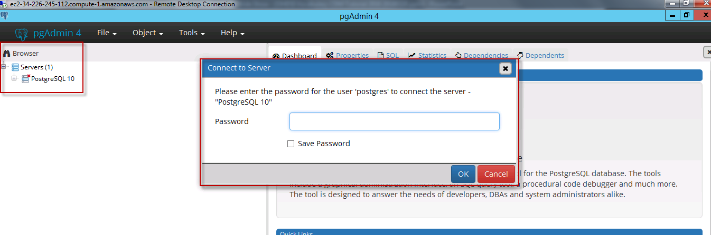
CDM Database: Connect
Password: ohdsi

Slide 36
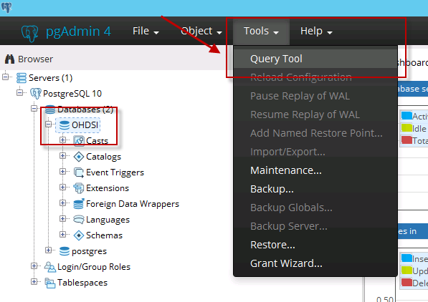
CDM Database: Open SQL Sheet

Slide 37
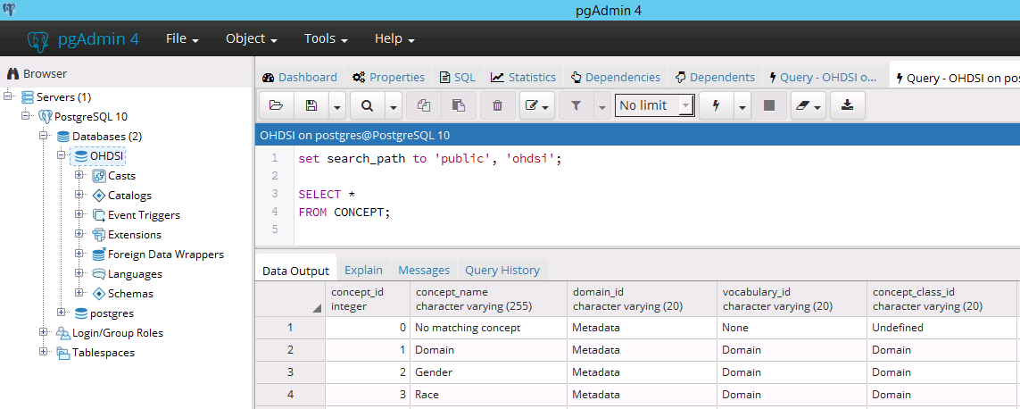
CDM Database: Ready
set search_path to 'ohdsi';

Slide 38
Vocabulary
Basic Relationship, Ancestors, & Descendants How does it work for Drugs SQL Examples

Slide 39
OMOP Common Vocabulary Model
What it is
Standardized structure to house existing vocabularies used in the public domain
Compiled standards from disparate public and private sources and some OMOP-grown concepts
What it’s not
Static dataset – the vocabulary updates regularly to keep up with the continual evolution of the sources
Finished product – vocabulary maintenance and improvement is ongoing activity that requires community participation and support

Slide 40
CDM Version 6 Key Domains
Person
Standardized health system data
Standardized metadata
Observation_period
CDM_source
Location
Standardized vocabularies
Visit_occurrence
Metadata
Location_history
Visit_detail
Standardized derived elements
Care_site
Condition_occurrence
Provider
Drug_exposure
Concept
Procedure_occurrence
Vocabulary
Device_exposure
Condition_era
Standardized clinical data
Domain
Drug_era
Measurement
Concept_class
Dose_era
Note
Standardized health economics
Concept_relationship
Results Schema
Note_NLP
Cohort
Relationship
Survey_conduct
Cohort_definition
Concept_synonym
Observation
Concept_ancestor
Specimen
Cost
Source_to_concept_map
Fact_relationship
Payer_plan_period
Drug_strength

Slide 41
Structure of OMOP Vocabulary
All content: concepts in concept
Direct relationships between concepts in concept_relationship
Multi-step hierarchical relationships pre-processed into concept_ancestor

Slide 42
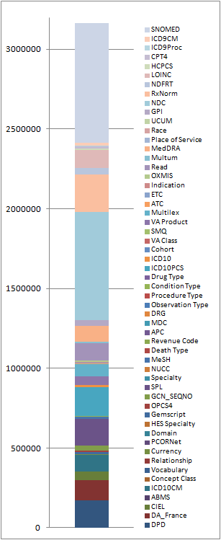
Single Concept Reference Table
All vocabularies stacked up in one table
Vocabulary ID

Slide 43
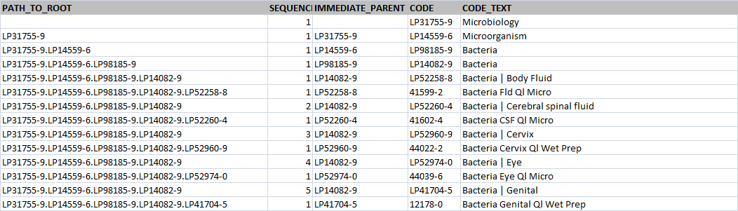
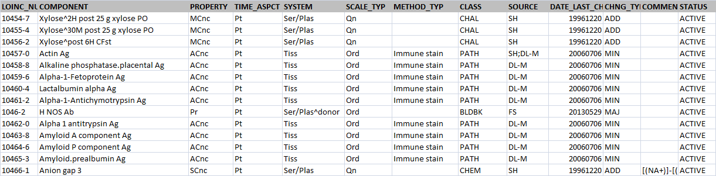
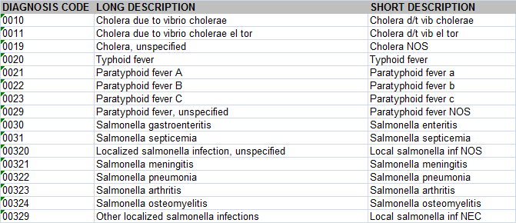
Dozens of schemes, formats, rules
LOINC_248_MULTI-AXIAL_HIERARCHY.CSV
loinc.csv
CMS32_DESC_LONG_SHORT_DX.xlsx

Slide 44
What's in a Concept
For use in CDM
CONCEPT_ID | 313217
CONCEPT_NAME | Atrial fibrillation
DOMAIN_ID | Condition
VOCABULARY_ID | SNOMED
CONCEPT_CLASS_ID | Clinical Finding
STANDARD_CONCEPT | S
CONCEPT_CODE | 49436004
VALID_START_DATE | 01-Jan-1970
VALID_END_DATE | 31-Dec-2099
INVALID_REASON
English description
Domain
Vocabulary
Class in SNOMED
Concept in data
Code in SNOMED
Valid during time interval

Slide 45
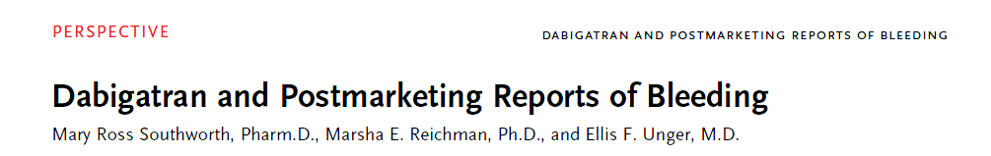
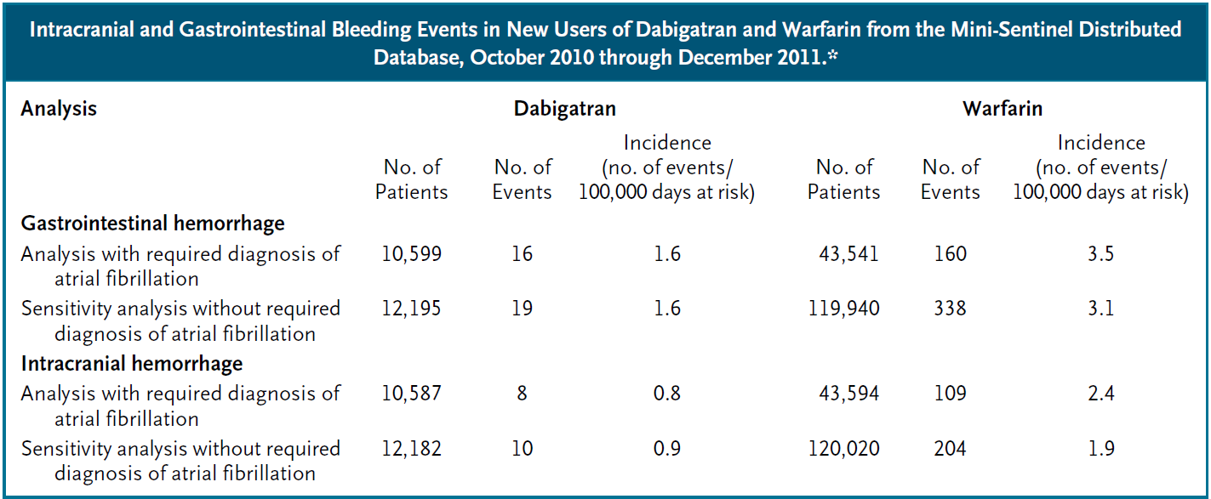
MiniSentinel in use: Dabigatran and bleeding
N Engl J Med 2013; 368:1272-1274

Slide 46
All Content in CDM is Coded as Concepts
Concepts are referred to by concept_id
All details are in the CONCEPT table:
SELECT *
FROM concept
WHERE concept_id = 313217

Slide 47
Condition Concepts
Classification Concepts
MedDRA
System organ class
Standard Concepts
MedDRA
High-level group terms
MedDRA
High-level terms
Top-level classification
SNOMED-CT
MedDRA
Preferred terms
Higher-level classifications
SNOMED-CT
MedDRA
Low-level terms
Low-level concepts
SNOMED-CT
Source Concepts
Source codes
ICD10
ICD10CM
Read
SNOMED
Oxmis
Ciel
MeSH
ICD9CM
Notes:
47

Slide 48
Finding the Right Concept #1
..if I know the ID
SELECT * FROM concept WHERE concept_id = 313217
..if I know the code
SELECT * FROM concept WHERE concept_code = '49436004'
CONCEPT _ID | CONCEPT_ NAME | DOMAIN _ID | VOCABULARY _ID | CONCEPT_ CLASS_ID | STANDARD_ CONCEPT | CONCEPT_ CODE | VALID_START _DATE | VALID_END _DATE | INVALID _REASON
313217 | Atrial fibrillation | Condition | SNOMED | Clinical Finding | S | 49436004 | 01-Jan-1970 | 31-Dec-2099
SNOMED code
CONCEPT _ID | CONCEPT_ NAME | DOMAIN _ID | VOCABULARY _ID | CONCEPT_ CLASS_ID | STANDARD_ CONCEPT | CONCEPT_ CODE | VALID_START _DATE | VALID_END _DATE | INVALID _REASON
313217 | Atrial fibrillation | Condition | SNOMED | Clinical Finding | S | 49436004 | 01-Jan-1970 | 31-Dec-2099

Slide 49
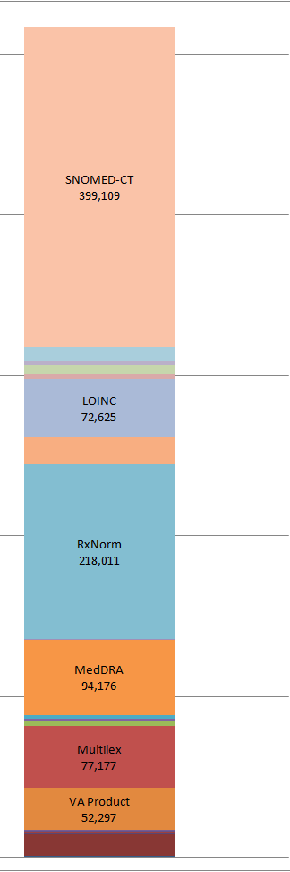
Concept ID versus Concept Code
SELECT *
FROM concept
WHERE concept_code = '1001';
Same code
Concept_Name | Concept Class | Vocabulary_ID | Concept_Code
Antipyrine | Ingredient | RxNorm | 1001
Aceprometazine maleate | Ingredient | BDPM | 1001
Serum | Specimen | CIEL | 1001
methixene hydrochloride | Ingredient | Multilex | 1001
Brompheniramine Maleate, 10 mg/mL injectable solution | Multum | Multum | 1001
ABBOTT COLD SORE BALM 4%/0.06% W/ | Drug Product | LPD_Australia | 1001
Residential Treatment - Psychiatric | Revenue Code | Revenue Code | 1001
Notes:
Suggestion is to add the concept ID to the beginning here to make it more clear that they are all different codes.

Slide 50
Finding the Right Concept #2
..if I know the name
SELECT * FROM concept WHERE concept_name = 'Atrial fibrillation';
CONCEPT _ID | CONCEPT_ NAME | DOMAIN _ID | VOCABULARY _ID | CONCEPT_ CLASS_ID | STANDARD_ CONCEPT | CONCEPT_ CODE
313217 | Atrial fibrillation | Condition | SNOMED | Clinical Finding | S | 49436004
44821957 | Atrial fibrillation | Condition | ICD9CM | 5-dig billing code |  | 427.31
35204953 | Atrial fibrillation | Condition | MedDRA | PT | C | 10003658
45500085 | Atrial fibrillation | Condition | Read | Read |  | G573000
45883018 | Atrial fibrillation | Meas Value | LOINC | Answer | S | LA17084-7

Slide 51
Finding the Right Concept #3
if don't know any of this, but I know the code in another vocabulary
SELECT * FROM concept WHERE concept_code = '427.31';
ICD-9 is not a Standard Concept
CONCEPT _ID | CONCEPT_ NAME | DOMAIN _ID | VOCABULARY _ID | CONCEPT_ CLASS_ID | STANDARD_ CONCEPT | CONCEPT_ CODE
44821957 | Atrial fibrillation | Condition | ICD9CM | 5-dig billing code |  | 427.31
SELECT * FROM concept_relationship WHERE concept_id_1 = 44821957;
Mapping to different vocabularies
Kind of relationship
CONCEPT _ID_1 | CONCEPT _ID_2 | RELATIONSHIP _ID | VALID_START _DATE | VALID_END _DATE | INVALID _REASON
44821957 | 21001551 | ICD9CM - FDB Ind | 01-Oct-13 | 31-Dec-2099
44821957 | 35204953 | ICD9CM - MedDRA | 01-Jan-70 | 31-Dec-2099
44821957 | 44824248 | Is a | 01-Oct-14 | 31-Dec-2099
44821957 | 44834731 | Is a | 01-Oct-14 | 31-Dec-2099
44821957 | 313217 | Maps to | 01-Jan-70 | 31-Dec-2099

Slide 52

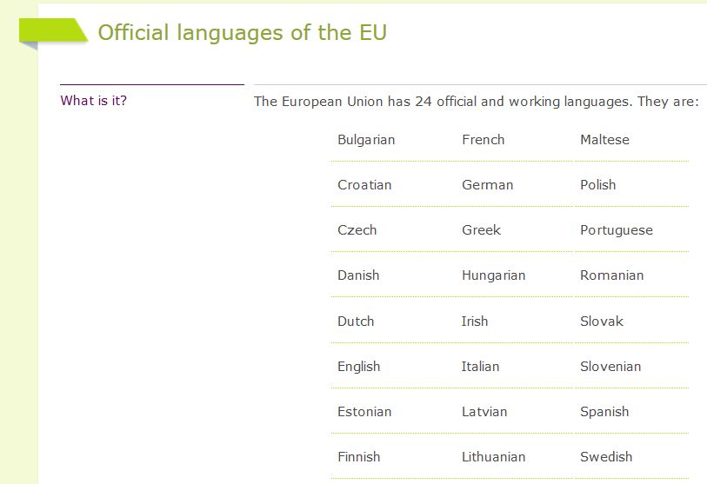
Why are we mapping?

Slide 53
How many different ways do you express one meaning?
Gëzuar
Наздраве
Salut
Na zdravi
Skål
Cheers
Živjeli
Proost
Terviseks
Skál
Santé
Salud
На здравје
Kippis
Υγεια
Zum Wohl
Fenékig
Sláinte
Noroc
Salute
Saúde
į sveikatą
Priekā
Na zdrowie
На здоровье

Slide 54

Mapping = Translating
Step 1. Lookup the Source Concept
SELECT * FROM concept WHERE concept_code = '427.31';
CONCEPT _ID | CONCEPT_ NAME | DOMAIN _ID | VOCABULARY _ID | CONCEPT_ CLASS_ID | STANDARD_ CONCEPT | CONCEPT_ CODE
44821957 | Atrial fibrillation | Condition | ICD9CM | 5-dig billing code |  | 427.31
Step 2. Translate to Standard
SELECT * FROM concept_relationship WHERE concept_id_1 = 44821957 AND relationship_id = 'Maps to';
CONCEPT _ID_1 | CONCEPT _ID_2 | RELATIONSHIP _ID | VALID_START _DATE | VALID_END _DATE | INVALID _REASON
44821957 | 313217 | Maps to | 01-Jan-1970 | 31-Dec-2099
Step 3. Check out the translated Concept
SELECT * FROM concept WHERE concept_id = 313217;

Slide 55

Exercise: Find Standard Concept ID from Source Concept
: 313217
: 313217
: 4154290 'Paroxysmal Atrial Fibrillation'
ICD9: '427.31'
ICD10CM: 'I48.91'
ICD10: 'I48.0'
Concept
?
Source codes
ICD9CM 427.31 Atrial Fibrillation
ICD10CM I48.91 Atrial Fibrillation
ICD10CM I48.0 Atrial Fibrillation
Step 1. Lookup
SELECT * FROM concept WHERE concept_code = ...;
Step 2. Translate
SELECT * FROM concept_relationship WHERE concept_id_1 = ...
AND relationship_id = 'Maps to';
Step 3. Check out
SELECT * FROM concept WHERE concept_id = ...;

Slide 56

Break
Please return in 15 minutes

Slide 57
Reason #2: Disease Hierarchy
Disease of the cardiovascular system
Heart disease
Cardiac arrhythmia
Supraventricular arrhythmia
SNOMED Concepts
Fibrillation
Atrial arrhythmia
Concept Relationships
Atrial fibrillation
Controlled atrial fibrillation
Persistent atrial fibrillation
Chronic atrial fibrillation
Paroxysmal atrial fibrillation
Rapid atrial fibrillation
Permanent atrial fibrillation

Slide 58
Exploring Relationships
CONCEPT _ID_1 | CONCEPT _ID_2 | RELATIONSHIP _ID
313217 | 4232697 | Subsumes
313217 | 4181800 | Focus of
313217 | 35204953 | SNOMED - MedDRA eq
313217 | 4203375 | Asso finding of
313217 | 4141360 | Subsumes
313217 | 4119601 | Subsumes
313217 | 4117112 | Subsumes
313217 | 4232691 | Subsumes
313217 | 4139517 | Due to of
313217 | 4194288 | Asso finding of
313217 | 44782442 | Subsumes
313217 | 44783731 | Focus of
313217 | 21003018 | SNOMED - ind/CI
313217 | 40248987 | SNOMED - ind/CI
313217 | 21001551 | SNOMED - ind/CI
313217 | 21001540 | SNOMED - ind/CI
313217 | 45576876 | Mapped from
313217 | 44807374 | Asso finding of
313217 | 21013834 | SNOMED - ind/CI
313217 | 21001572 | SNOMED - ind/CI
313217 | 21001606 | SNOMED - ind/CI
313217 | 21003176 | SNOMED - ind/CI
313217 | 4226399 | Is a
313217 | 500001801 | SNOMED - HOI
313217 | 500002401 | SNOMED - HOI
313217 | 4119602 | Subsumes
313217 | 40631039 | Subsumes
313217 | 4108832 | Subsumes
313217 | 21013671 | SNOMED - ind/CI
313217 | 21013390 | SNOMED - ind/CI
313217 | 313217 | Maps to
313217 | 44821957 | Mapped from
313217 | 2617597 | Mapped from
313217 | 45500085 | Mapped from
313217 | 313217 | Mapped from
313217 | 45951191 | Mapped from
313217 | 21013856 | SNOMED - ind/CI
313217 | 21001575 | SNOMED - ind/CI
313217 | 21001594 | SNOMED - ind/CI
313217 | 21001542 | SNOMED - ind/CI
313217 | 21001595 | SNOMED - ind/CI
313217 | 21001687 | SNOMED - ind/CI
313217 | 21001529 | SNOMED - ind/CI
313217 | 42709991 | Focus of
313217 | 4093357 | Has finding site
313217 | 4199501 | Subsumes
313217 | 4068155 | Is a
313217 | 4154290 | Subsumes
313217 | 4242112 | Has finding site
313217 | 4344544 | SNOMED - ind/CI
313217 | 37395821 | Subsumes
313217 | 21005673 | SNOMED - ind/CI
313217 | 21001550 | SNOMED - ind/CI
313217 | 45611600 | Mapped from
SELECT *
FROM concept_relationship
WHERE concept_id_1 = 313217
Related Concepts
Relationship ID

Slide 59
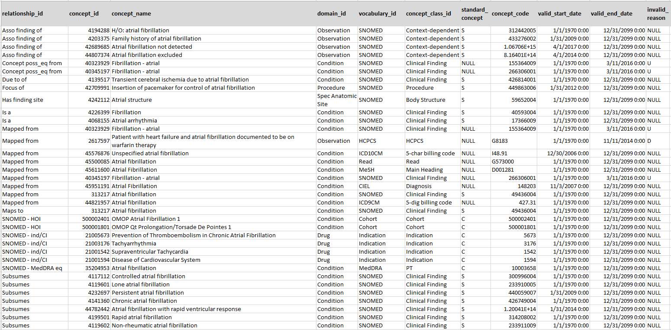
Exploring Relationships
Find out related concept
SELECT cr.relationship_id, c.*
FROM concept_relationship cr
JOIN concept c ON cr.concept_id_2 = c.concept_id
WHERE cr.concept_id_1 = 313217
Ancestor concepts
Descendant concepts

Slide 60
Ancestry Relationships: Higher-Level Relationships
5 levels of separation
Disease of the cardiovascular system
Ancestry Relationships
Ancestor
Heart disease
Cardiac arrhythmia
Supraventricular arrhythmia
Concepts
2 levels of separation
Fibrillation
Atrial arrhythmia
Concept Relationships
Atrial fibrillation
Descendant
Controlled atrial fibrillation
Persistent atrial fibrillation
Chronic atrial fibrillation
Paroxysmal atrial fibrillation
Rapid atrial fibrillation
Permanent atrial fibrillation

Slide 61
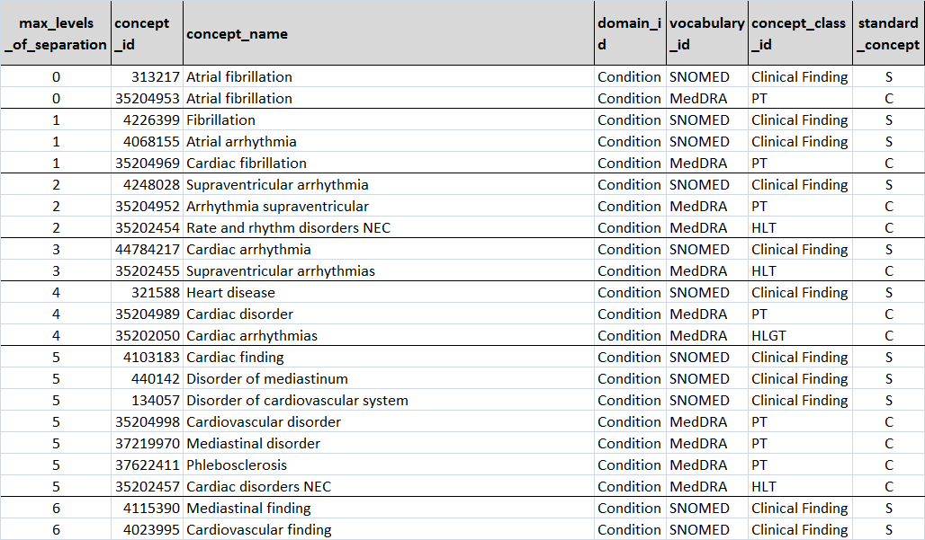
Exploring Ancestors of a Concept
SELECT max_levels_of_separation, concept.*
FROM concept_ancestor
JOIN concept ON ancestor_concept_id = concept_id
WHERE descendant_concept_id = 313217 /* Atrial fibrillation */
ORDER BY max_levels_of_separation
Hold the descendant

Slide 62
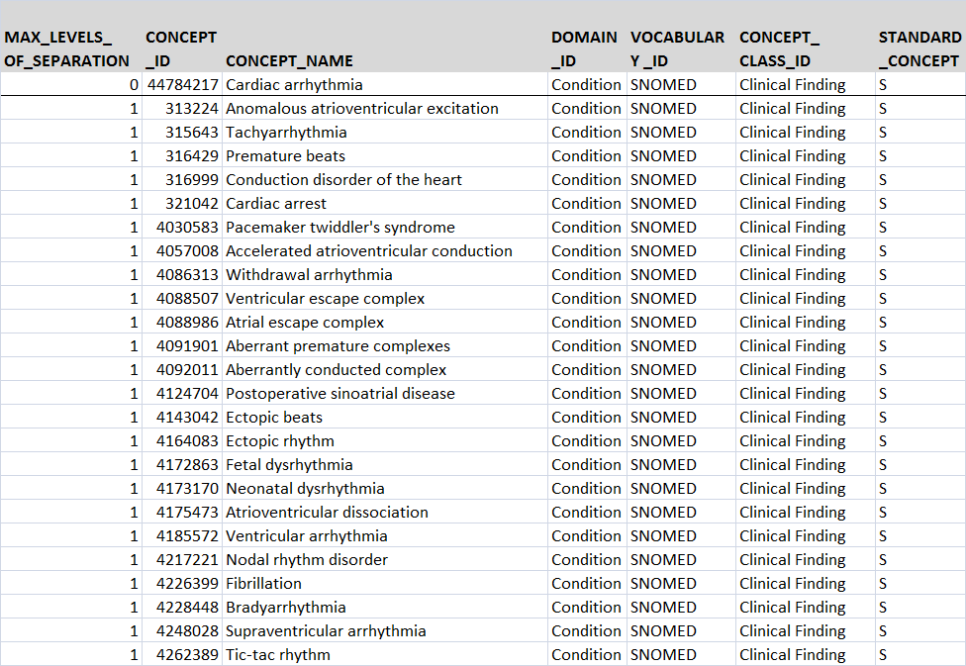
Exploring Descendants of a Concept
SELECT max_levels_of_separation, concept.*
FROM concept_ancestor
JOIN concept ON descendant_concept_id = concept_id
WHERE ancestor_concept_id = 44784217 /* cardiac arrythmia */
ORDER BY max_levels_of_separation
Hold the ancestor

Slide 63
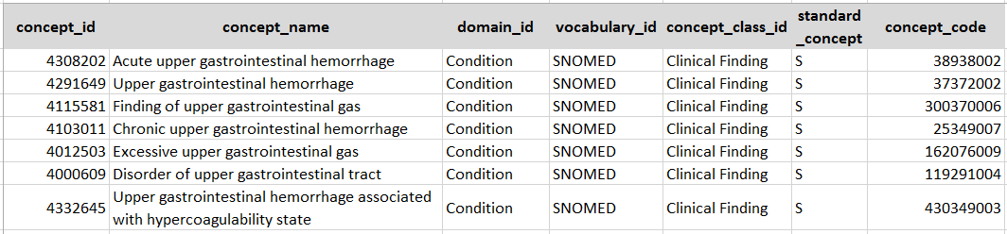
Let Us find Upper Gastrointestinal Bleeding
1. Find some initiation concept
SELECT * FROM concept WHERE concept_name = 'Upper gastrointestinal bleeding'
2. Find standard concepts
SELECT * FROM concept WHERE lower(concept_name) LIKE '%upper gastrointestinal%'
AND domain_id = 'Condition' AND standard_concept = 'S'

Slide 64
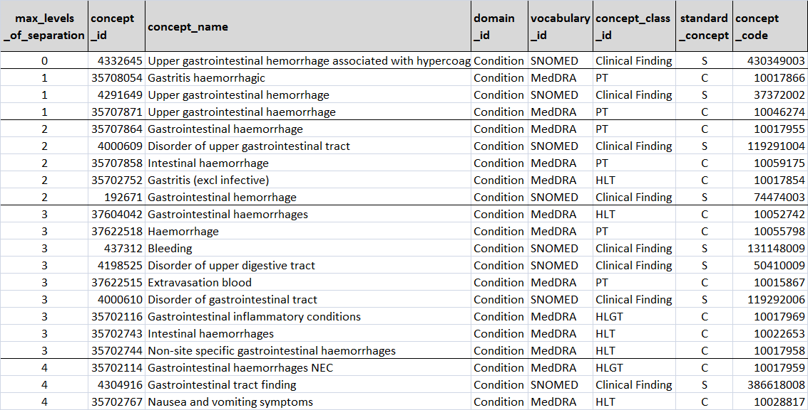
Going up the hierarchy: Finding the right concept
SELECT max_levels_of_separation, concept.*
FROM concept_ancestor
JOIN concept ON ancestor_concept_id = concept_id
WHERE descendant_concept_id = 4332645 /* Upper gastrointestinal hemorrhage associated...*/
ORDER BY max_levels_of_separation
Hold the descendant

Slide 65
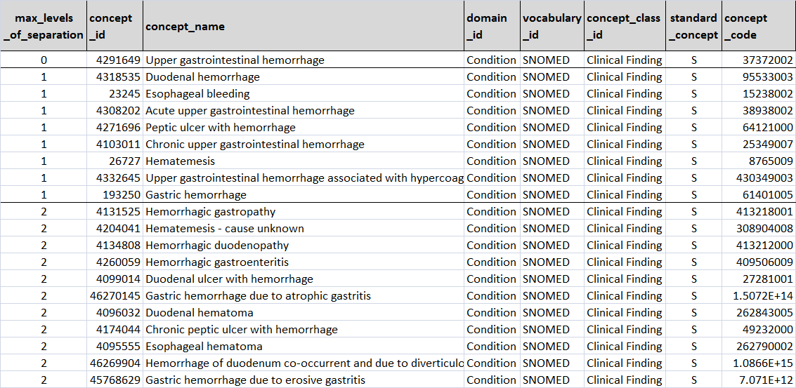
Going down the hierarchy : Checking the right content
SELECT max_levels_of_separation, concept.*
FROM concept_ancestor
JOIN concept ON descendant_concept_id = concept_id
WHERE ancestor_concept_id = 4291649 /* Upper gastrointestinal hemorrhage */
ORDER BY max_levels_of_separation
Concept 4291649 and all its descendants comprise Upper GI Bleeding

Slide 66
Exercise: Find Standard Concept ID for Conditions
Asthma
Plague
Ingrown toenail
Your favorite condition here
317009
434271
4065236
4290993

Slide 67
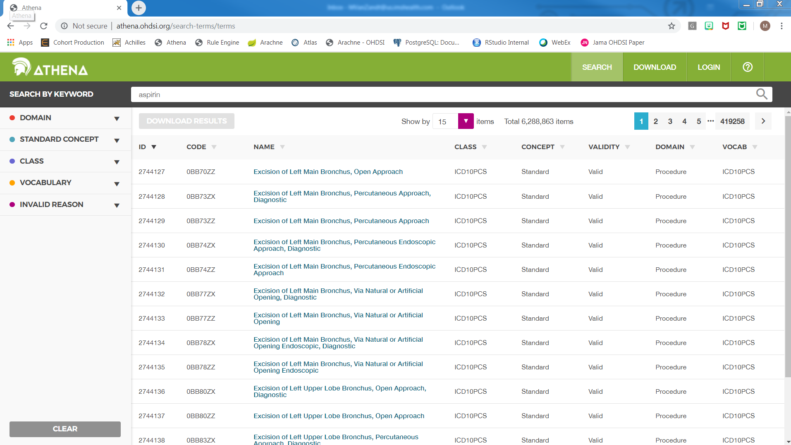
Athena

Slide 68

Lunch
Please return in 1 hour

Slide 69
Does it Work that Way with Drugs?
Codes
NDC, GPI, Multilex, HCPCS, etc.
Concepts
Drug products (Generic and Brand)
Drug ingredients
Drug Classes
Relationships
Ancestry

Slide 70
Drug Hierarchy
Drug Classes
Classifications
VA Class
CVX
NDFRT
NDFRT Ind
ATC
FDB Ind
ETC
SPL
SNOMED
VA Class
CVX
NDFRT
NDFRT Ind
ATC
FDB Ind
ETC
SPL
SNOMED
Drugs
Ingredients
RxNorm RxNorm Extension
Standard Concepts
Drug Forms and Components
RxNorm RxNorm Extension
Drug products
RxNorm RxNorm Extension
Source codes
CIEL
NDC
GPI
VA-Product
Gemscript
EU Product
DPD
HCPCS
MeSH
Multum
Oxmis
Read
Genseqno
dm+d
AMIS
BDPM
CPT4
Source Codes
Procedure Drugs

Slide 71
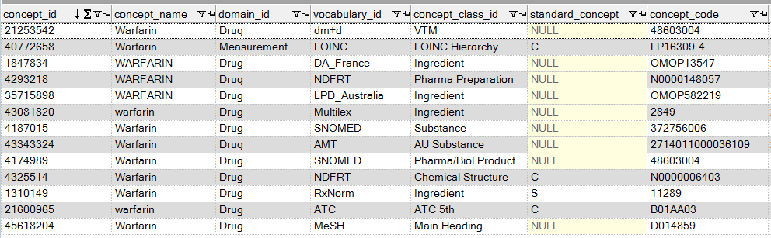
Let us find Warfarin
Find active compound Warfarin by keyword
SELECT * FROM concept WHERE lower(concept_name) = 'warfarin'

Slide 72
Let us find Clopidogrel
1. Find drug product containing Clopidogrel by NDC code:
Bristol Meyer Squibb's Plavix 75mg capsules: NDC 67544050474
SELECT * FROM concept WHERE concept_code = '67544050474'
SELECT * FROM concept_relationship WHERE concept_id_1 = 45867731 AND relationship_id = 'Maps to'
SELECT * FROM concept WHERE concept_id = 1322185

Slide 73
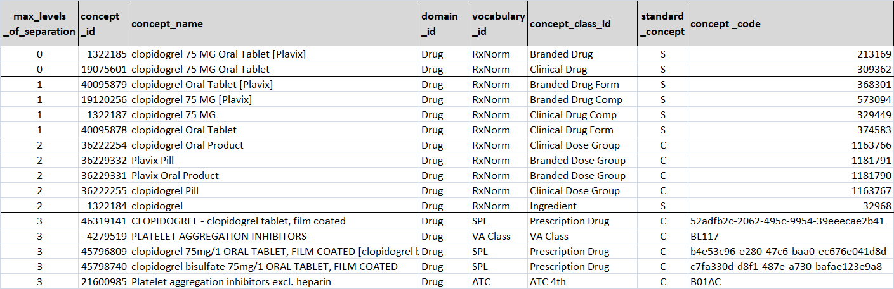
Let us find Clopidogrel ingredient
Find ingredient Clopidogrel as Ancestor of drug product
SELECT max_levels_of_separation, concept.*
FROM concept_ancestor
JOIN concept ON ancestor_concept_id = concept_id
WHERE descendant_concept_id = 1322185 /* clopidogrel 75 MG Oral Tablet [Plavix]*/
ORDER BY max_levels_of_separation
Clopidogrel
Drug classes

Slide 74
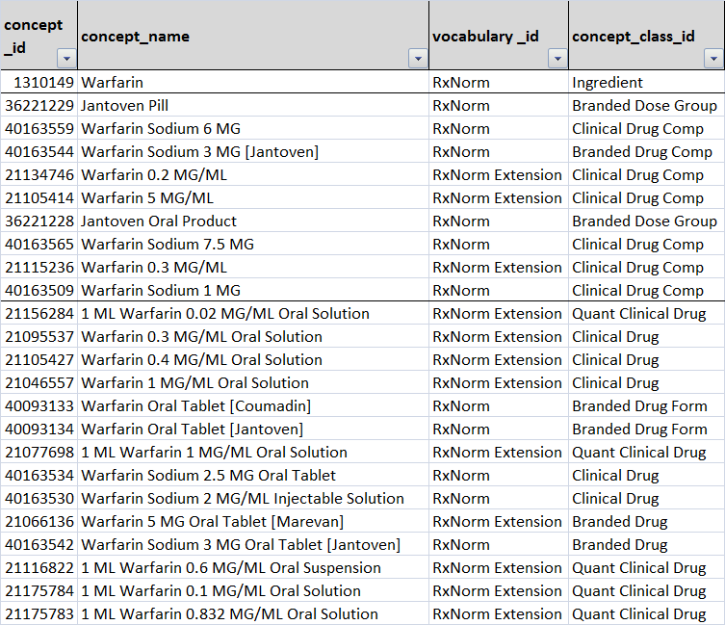
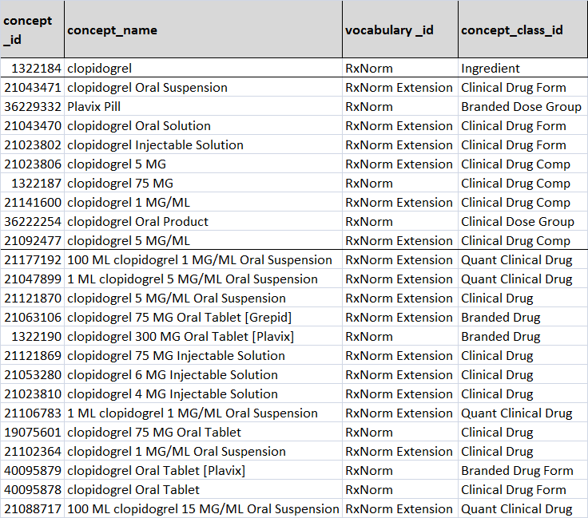
Check out Ingredients
Check Descendants (other drug products containing Warfarin and Dabigatran)
SELECT max_levels_of_separation, concept.*
FROM concept_ancestor
JOIN concept ON descendant_concept_id = concept_id
WHERE ancestor_concept_id = 1310149 /* Warfarin or 1322185 Clopidogrel*/
ORDER BY max_levels_of_separation

Slide 75
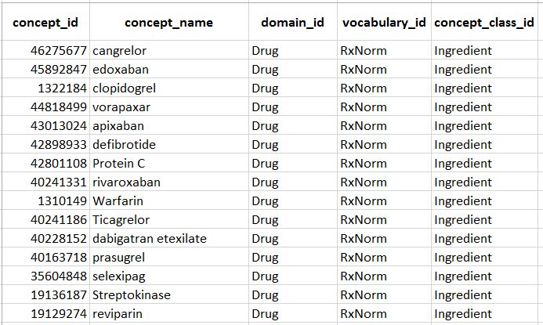
Find members of Drug Classes
4. Check Ingredient Descendants of Drug Class Anticoagulants
SELECT max_levels_of_separation, concept.*
FROM concept_ancestor
JOIN concept ON descendant_concept_id = concept_id
WHERE ancestor_concept_id = ﻿21600961 /* ﻿ATC Antithromboic Agent */
AND concept_class_id = ‘Ingredient'
ORDER BY max_levels_of_separation

Slide 76
Exercise: Find Standard Concept ID
Metformin
Tolazamide
Telmisartan
Your favorite ingredient here
1503297
1502809
1317640
Notes:
Speaker Notes: Reminder to show ATHENA

Slide 77
Exercise: Find Standard Concept ID
A10AE06
686450400
A10BD14
Your favorite drug here
35602717
19080217
???
Notes:
Speaker Notes: You will need to be able to explain why A10BD14 does not map to anything, but has ATC to RxNorm relationships

Slide 78
Common Data Model
In depth discussion of model & era discussion

Slide 79
CDM Version 6 Key Domains
Person
Standardized health system data
Standardized metadata
Observation_period
CDM_source
Location
Standardized vocabularies
Visit_occurrence
Metadata
Location_history
Visit_detail
Standardized derived elements
Care_site
Condition_occurrence
Provider
Drug_exposure
Concept
Procedure_occurrence
Vocabulary
Device_exposure
Condition_era
Standardized clinical data
Domain
Drug_era
Measurement
Concept_class
Dose_era
Note
Standardized health economics
Concept_relationship
Results Schema
Note_NLP
Cohort
Relationship
Survey_conduct
Cohort_definition
Concept_synonym
Observation
Concept_ancestor
Specimen
Cost
Source_to_concept_map
Fact_relationship
Payer_plan_period
Drug_strength
Notes:
.

Slide 80
OMOP CDM Principles
Patient centric
Vocabulary and Data Model are blended
Domain-oriented concepts
Accommodates data from various sources
Preserves data provenance
Extendable & Evolving
Database Platform Independent

Slide 81
OMOP CDM Standard Domain Features
Feature | Description & Purpose | Field Name Convention | Example
Patient centric | Every domain table has patient identifier. Patient data can be retrieved independently from other domains. | person_id | person_id 123
Unique domain identifiers | Ever domain table has a unique primary key to identify domain entities. | <entity>_id | condition_occurrence_id 470985
Standard concept from a respective vocabulary domain | Integration with the Vocabulary. Foreign key into the Standard Vocabulary for Standard Concept. | <entity>_concept_id | condition_concept_id 313217 (SNOMED “Atrial Fibrillation”)
Source value | Provenance. Verbatim information from the source data, not to be used by any standard analytics. | <entity>_source_value | condition_source_value 427.31 (ICD9CM “Atrial Fibrillation”)
Source concept from a respective vocabulary domain | Provenance. Foreign key into Standard Vocabulary for Source Concept. | <entity>_source_concept_id | condition_source_concept_id 44821957 (ICD9CM “Atrial Fibrillation”)
Source type | Provenance. Foreign key into Vocabulary for the origin of the data. | <entity>_type_concept_id | condition_type_concept_id 38000199 (“Inpatient header – primary”)

Slide 82





A Patient’s Story: Lauren
https://www.endometriosis-uk.org/laurens-story

Slide 83

What data do we have?
Guided Exercise:
Where and how do we think Lauren’s data is generated?
Where do we think Lauren’s data could go into the CDM?

Slide 84
What data do we have?
dysmenorrhea
abdominal pain
missed work
missed work
acetaminophen
acetaminophen
acetaminophen
GP visit
ultrasound
pelvic exam
cyst of ovary
Hospital Visit
severe pain
temp 103°F
ultrasound
ambulance
Bloated abdomen
ascites
surgery
endometrioma
Lauren’s Timeline
Endometriosis
/ /
/ /
-3 Years
-2 Years
-1 Years
-2 Weeks
-3 Days
Day 0

Slide 85
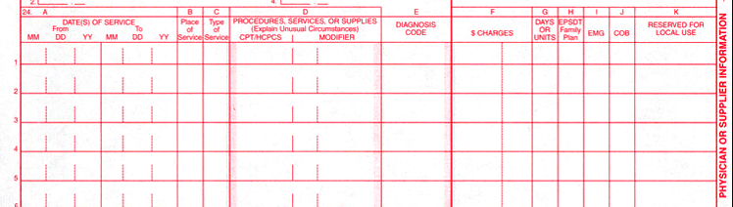
Examples of how Researchers get Lauren’s data?
Health Insurance Claim Form (HCFA-1500)
Universal Billing form (UB-92)
Notes:
Health Insurance Claim Form (HCFA1500) and Universal Billing form (UB-92). Health care services provided by a single practitioner or practitioner groups are submitted for payments on the HCFA-1500 form, while hospital inpatient and acute care outpatient services are submitted for payments on the UB-92 format.

Slide 86
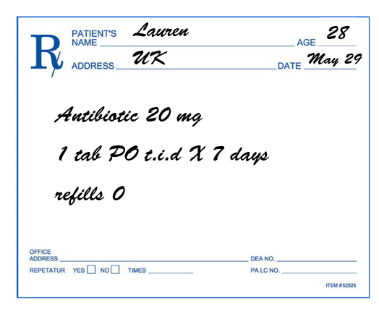
Examples of how Researchers get Lauren’s data?
Health Insurance Claim Form (HCFA-1500)
Universal Billing form (UB-92)
Prescriptions

Slide 87
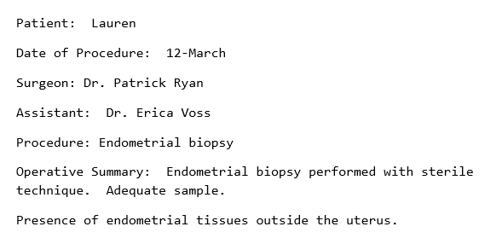
Examples of how Researchers get Lauren’s data?
Health Insurance Claim Form (HCFA-1500)
Universal Billing form (UB-92)
Prescriptions
Doctors notes

Slide 88
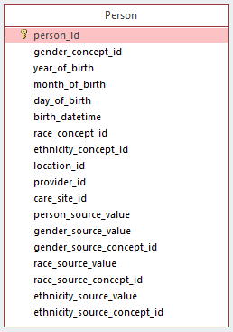
PERSON
Need to create one unique record per person
No history of location/demographics: need to select latest available
Year of birth required…day/month optional
Foreign key to the LOCATION, PROVIDER, and CARE_SITE table that contains one record

Slide 89
What data do we have?
dysmenorrhea
abdominal pain
missed work
missed work
acetaminophen
acetaminophen
acetaminophen
GP visit
ultrasound
pelvic exam
cyst of ovary
Hospital Visit
severe pain
temp 103°F
ultrasound
ambulance
Bloated abdomen
ascites
surgery
endometrioma
Lauren’s Timeline
Endometriosis
/ /
/ /
-3 Years
-2 Years
-1 Years
-2 Weeks
-3 Days
Day 0

Slide 90
PERSON
COLUMN | EXAMPLE
person_id | 123456
gender_concept_id | 8532
year_of_birth | 1982
month_of_birth | NULL
day_of_birth | NULL
race_concept_id | 8527
ethnicity_concept_id | 0
person_source_value | 123456
gender_source_value | F
race_source_value | W
ethnicity_source_value | NULL
Lauren’s ID
Female
White
sample of table’s columns

Slide 91
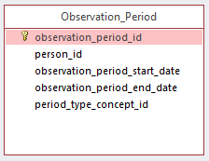
OBSERVATION_PERIOD
Spans of time where data source has capture of data
One person may have multiple periods if there is interruption in data capture
Required to run analytical methods
Challenge: determine observation periods based on the source data

Slide 92
What data do we have?
dysmenorrhea
abdominal pain
missed work
missed work
acetaminophen
acetaminophen
acetaminophen
GP visit
ultrasound
pelvic exam
cyst of ovary
Hospital Visit
severe pain
temp 103°F
ultrasound
ambulance
Bloated abdomen
ascites
surgery
endometrioma
Lauren’s Timeline
Endometriosis
Lauren’s Timeline
/ /
/ /
/ /
-2 Weeks
/ /
-3 Days
-2 Weeks
-3 Days
Day 0
-2 Years
-1 Years
Day 0
-3 Years
-2 Years
-1 Years
-3 Years

Slide 93
OBSERVATION_PERIOD
COLUMN | EXAMPLE
observation_period_id | 1
person_id | 123456
observation_periods_start_date | 2000-01-01
observation_periods_start_date | 2010-12-31
Lauren’s ID
COLUMN | EXAMPLE
observation_period_id | 2
person_id | 123456
observation_periods_start_date | 2012-01-01
observation_periods_start_date | 2013-12-31
Lauren’s ID
sample of table’s columns

Slide 94
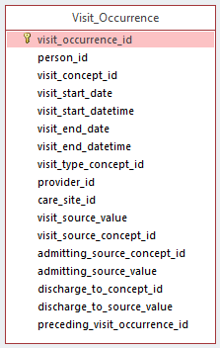
VISIT_OCCURRENCE
Visits are ‘Encounters’
Contains spans of time where a person receives medical services
Visit Types
Emergency room
Inpatient
Inpatient/Emergency
Outpatient
Long-term care

Slide 95
What data do we have?
dysmenorrhea
abdominal pain
missed work
missed work
acetaminophen
acetaminophen
acetaminophen
GP visit
ultrasound
GP visit
pelvic exam
cyst of ovary
Hospital Visit
Hospital Visit
severe pain
temp 103°F
ultrasound
ambulance
Bloated abdomen
ascites
surgery
endometrioma
Lauren’s Timeline
Endometriosis
/ /
/ /
-3 Years
-2 Years
-1 Years
-2 Weeks
-3 Days
Day 0

Slide 96
VISIT_OCCURRENCE
COLUMN | EXAMPLE
visit_occurrence_id | 1
person_id | 123456
visit_start_date | 2008-04-07
visit_end_date | 2008-04-07
visit_concept_id | 9202
visit_source_value | OP
Lauren’s ID
Outpatient Visit
COLUMN | EXAMPLE
visit_occurrence_id | 2
person_id | 123456
visit_start_date | 2008-04-21
visit_end_date | 2008-04-26
visit_concept_id | 9201
visit_source_value | IP
Lauren’s ID
Inpatient Visit
sample of table’s columns

Slide 97
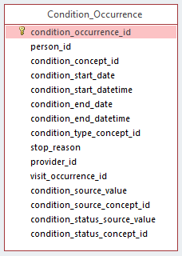
CONDITION_OCCURRENCE
Records suggesting the presence of a disease or medical condition stated as a diagnosis, a sign or a symptom
Examples:
Billing diagnosis
Problem list
Notes:
Conditions are records of a person suggesting the presence of a disease or medical condition stated as a diagnosis, a sign or a symptom, which is either observed by a Provider or reported by the patient.

Slide 98
What data do we have?
abdominal pain
dysmenorrhea
abdominal pain
dysmenorrhea
missed work
missed work
acetaminophen
acetaminophen
acetaminophen
GP visit
ultrasound
pelvic exam
cyst of ovary
cyst of ovary
Hospital Visit
severe pain
severe pain
temp 103°F
ultrasound
ascites
ambulance
Bloated abdomen
ascites
surgery
Bloated abdomen
endometrioma
endometrioma
Endometriosis
Lauren’s Timeline
Endometriosis
/ /
/ /
-3 Years
-2 Years
-1 Years
-2 Weeks
-3 Days
Day 0

Slide 99
CONDITION_OCCURRENCE
COLUMN | EXAMPLE
condition_occurrence_id | 1
person_id | 123456
condition_concept_id | 433527
condtition_start_date | 2008-04-24
condition_start_datetime | 2008-04-24 00:00:00
condition_type_concept_id | 38000183
condition_status_concept_id | 4230359
visit_occurrence_id | 2
condition_source_value | 6171
condition_source_concept_id | 44832501
Lauren’s ID
Endometriosis
Inpatient detail - primary
ICD9, missing decimal
Endometriosis of ovary
sample of table’s columns

Slide 100
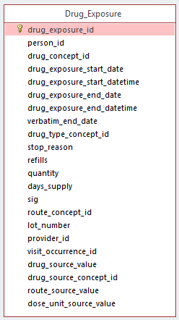
DRUG_EXPOSURE
Records about the utilization of a drug when ingested or otherwise introduced into the body
Data sources:
Pharmacy dispensing
Prescriptions written
Medication history
If drug is represented as a procedure, the OMOP Vocabulary realigns as drug

Slide 101
What data do we have?
dysmenorrhea
abdominal pain
missed work
missed work
acetaminophen
acetaminophen
acetaminophen
acetaminophen
acetaminophen
acetaminophen
GP visit
ultrasound
pelvic exam
cyst of ovary
Hospital Visit
severe pain
temp 103°F
ultrasound
ambulance
Bloated abdomen
ascites
surgery
endometrioma
Lauren’s Timeline
Endometriosis
/ /
/ /
-3 Years
-2 Years
-1 Years
-2 Weeks
-3 Days
Day 0

Slide 102
DRUG_EXPOSURE
COLUMN | EXAMPLE
drug_exposure_id | 1
person_id | 123456
drug_concept_id | 40162494
drug_exposure_start_date | 2007-02-01
drug_exposure_end_date | 2007-02-08
verbatim_end_date | NULL
drug_type_concept_id | 38000183
refills | 0
quantity | 14
days_supply | 7
drug_source_value | 54348001301
drug_source_concept_id | 45904353
Lauren’s ID
Acetaminophen 500 MG / Hydrocodone Bitartrate 5 MG Oral Tablet
Drug_exposure_start_date + days_supply
Prescription dispensed in pharmacy
NDC 11-digit code
Acetaminophen 500 MG / Hydrocodone Bitartrate 5 MG Oral Tablet
sample of table’s columns

Slide 103
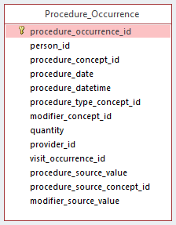
PROCEDURE_OCCURRENCE
Contains records of activities or processes ordered by, or carried out by, a healthcare provider on the patient to have a diagnostic or therapeutic purpose
Vocabularies include CPT-4, HCPCS, ICD-9 Procedures, ICD-10 Procedures, LOINC, SNOMED
Procedures have the least standardized vocabularies that causes some redundancy

Slide 104
What data do we have?
dysmenorrhea
abdominal pain
missed work
missed work
acetaminophen
acetaminophen
acetaminophen
ultrasound
GP visit
ultrasound
pelvic exam
pelvic exam
cyst of ovary
Hospital Visit
severe pain
ultrasound
temp 103°F
ultrasound
ascites
surgery
ambulance
Bloated abdomen
surgery
endometrioma
Lauren’s Timeline
Endometriosis
/ /
/ /
-3 Years
-2 Years
-1 Years
-2 Weeks
-3 Days
Day 0

Slide 105
PROCEDURE_OCCURRENCE
COLUMN | EXAMPLE
procedure_occurrence_id | 1
person_id | 123456
procedure_concept_id | 2211740
procedure_date | 2008-04-08
procedure_type_concept_id | 38000267
visit_occurrence_id | 1
procedure_source_value | 76700
procedure_source_concept_id | 2211740
Lauren’s ID
Ultrasound, abdominal, real time with image documentation; complete
Outpatient detail - 1st position
CPT4
Ultrasound, abdominal, real time with image documentation; complete
sample of table’s columns

Slide 106
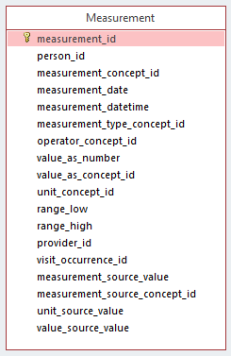
MEASUREMENT
Contains records of Measurement, i.e. structured values (numerical or categorical) obtained through systematic and standardized examination or testing of a Person or Person's sample
Data sources: structured, quantitative measures, such as laboratory tests
Measures have associated units

Slide 107
What data do we have?
dysmenorrhea
abdominal pain
missed work
missed work
acetaminophen
acetaminophen
acetaminophen
GP visit
ultrasound
pelvic exam
cyst of ovary
Hospital Visit
severe pain
temp 103°F
ultrasound
temp 103°F
ambulance
Bloated abdomen
ascites
surgery
endometrioma
Lauren’s Timeline
Endometriosis
/ /
/ /
-3 Years
-2 Years
-1 Years
-2 Weeks
-3 Days
Day 0

Slide 108
MEASUREMENT
COLUMN | EXAMPLE
measurement_id | 1
person_id | 123456
measurement_concept_id | 3020891
measurement_date | 2008-04-21
measurement_type_concept_id | 44818701
value_as_number | 103
unit_concept_id | 9289
measurement_source_value | 8310-5
measurement_source_concept_id | 3020891
Lauren’s ID
Body temperature
From physical examination
Degree Fahrenheit
LOINC
Body temperature
sample of table’s columns

Slide 109

OBSERVATION
Captures clinical facts about a Person obtained in the context of examination, questioning or a procedure
Any data that cannot be represented by any other domains, such as social and lifestyle facts, medical history, family history, etc. are recorded here
Instrument for CDM extension, playpen

Slide 110
What data do we have?
dysmenorrhea
abdominal pain
missed work
missed work
missed work
missed work
acetaminophen
acetaminophen
acetaminophen
GP visit
ultrasound
pelvic exam
cyst of ovary
Hospital Visit
severe pain
temp 103°F
ultrasound
ambulance
ascites
surgery
ambulance
Bloated abdomen
endometrioma
Lauren’s Timeline
Endometriosis
/ /
/ /
-3 Years
-2 Years
-1 Years
-2 Weeks
-3 Days
Day 0

Slide 111
OBSERVATION
COLUMN | EXAMPLE
observation_id | 1
person_id | 123456
observation_concept_id | 0
observation_date | 2006-01-20
observation_type_concept_id | 44814721
value_as_number | 8
value_as_string | Work Hours Missed
observation_source_value | Work Hours Missed
observation_source_concept_id | 0
Lauren’s ID
No matching concept
Patient reported
No matching concept
sample of table’s columns
Notes:
health & productivity management data

Slide 112
CDM Version 6 Key Domains
Person
Standardized health system data
Standardized metadata
Observation_period
CDM_source
Location
Standardized vocabularies
Visit_occurrence
Metadata
Location_history
Visit_detail
Standardized derived elements
Care_site
Condition_occurrence
Provider
Drug_exposure
Concept
Procedure_occurrence
Vocabulary
Device_exposure
Condition_era
Standardized clinical data
Domain
Drug_era
Measurement
Concept_class
Dose_era
Note
Standardized health economics
Concept_relationship
Results Schema
Note_NLP
Cohort
Relationship
Survey_conduct
Cohort_definition
Concept_synonym
Observation
Concept_ancestor
Specimen
Cost
Source_to_concept_map
Fact_relationship
Payer_plan_period
Drug_strength
Notes:
This is a data diagram/data model
Everything starts with a person, again, making this patient centric.

Slide 113

DRUG_ERA
Standardized inference of length of exposure to product for all active ingredients
Derived from records in DRUG_EXPOSURE under certain rules to produce continuous Drug Eras

Slide 114
DRUG_ERA
DRUG_EXPOSURE
Acetaminophen 500 MG / Hydrocodone Bitartrate 5 MG Oral Tablet
COLUMN | EXAMPLE
drug_exposure_id | 1
person_id | 123456
drug_concept_id | 40162494
drug_exposure_start_date | 2007-02-01
drug_exposure_end_date | 2007-02-08
COLUMN | EXAMPLE
drug_era_id | 1
person_id | 123456
drug_concept_id | 1125315
drug_era_start_date | 2007-02-01
drug_era_end_date | 2007-02-17
Acetaminophen
COLUMN | EXAMPLE
drug_exposure_id | 2
person_id | 123456
drug_concept_id | 40162494
drug_exposure_start_date | 2007-02-10
drug_exposure_end_date | 2007-02-17
COLUMN | EXAMPLE
drug_era_id | 2
person_id | 123456
drug_concept_id | 1174888
drug_era_start_date | 2007-02-01
drug_era_end_date | 2007-02-17
Hydrocodone
sample of table’s columns

Slide 115
Illustrating inferences needed within longitudinal pharmacy claims data for one patient
Person Timeline
Lisinopril era 1
Era 2
NDC: 00179198801
Lisinopril 5 MG Oral Tablet
30d
How do we handle reversals?
X
60d
How do we infer discontinuation?
NDC: 00310013010
ZESTRIL 5 MG TABLET
How do we handle NDC change?
NDC: 00038013134
Lisinopril 10 MG Oral Tablet [Zestril]
How do we handle overlap?
30d gap
NDC: 00038013210
Lisinopril 20 MG Oral Tablet [Zestril]
How do we handle change in dose?
How do we handle gaps?
NDC: 58016078020
Hydrochlorothiazide 12.5 MG / Lisinopril 20 MG Oral Tablet [Zestoretic]
How do we handle combination products?
Prescription dispensing (Fill date + days supply)
Notes:
115

Slide 116

CDM Tables Not Covered in Detail
VISIT_DETAIL
SPECIMEN
DEATH
DEVICE_EXPOSURE
NOTE
NOTE_NLP
FACT_RELATIONSHIP
LOCATION
CARE_SITE
PROVIDER
PAYER_PLAN_PERIOD
COST
COHORT
COHORT_ATTRIBUTES
CONDITITION_ERA
DOSE_ERA
CDM_SOURCE

Slide 117

Standards
Patients without transaction
Cleaning dirty data
Patient IDs reused
Bogus code records (e.g. ‘000’)
How to handle tobacco information
https://github.com/OHDSI/CommonDataModel/wiki

Slide 118
CDM Version Control
Working group meets once a month to discuss proposed changes to the CDM
All CDM documentation, versions, and proposals located on GitHub
https://github.com/OHDSI/CommonDataModel
Proposals tracked and discussed as GitHub issues
https://ohdsi.github.io/TheBookOfOhdsi/CommonDataModel.html
Meeting information can be found on the working group wiki page
Please contact Clair Blacketer (mblacke@its.jnj.com) for more information

Slide 119
Break
Please return in 15 minutes

Slide 120
CDM Examples
Leveraging OHDSI Tools (GitHub /Forums/ Working Group) Exercises

Slide 121
ETL: Real world scenario
PharMetrics Plus CLAIMS
pat_id | claimno | from_dt | to_dt | diagprc_ind | Diag_admit | diag1
05917921689 | IPA333393946 | 1/5/2006 | 1/5/2006 | 1 | 41071 | 41071
LRx/Dx MEDICAL_CLAIMS
md_clm_id | ims_pat_nbr | dt_of_service | rxer_id | diag_cd
95963982102 | 80445908 | 8/1/2012 0:00 | 680488 | 41071
German DA Problem Events
db_country | international_practice_num | international_doctor_num | international_patient_num | age_at_event | date_of_event | international_diagnosis_num
GE | GE6326 | GE8784 | GE46478747 | 20 | 11/19/2014 0:00 | GE2397573
4 real observational databases, all containing an inpatient admission for a patient with a diagnosis of ‘acute subendocardial infarction’
Not a single table name the same…
Not a single variable name the same….
Different table structures (rows vs. columns)
Different conventions (with and without decimal points)
Different coding schemes (ICD9 vs. ICD10)
Diagnosis
db_country | international_diagnosis_num | diagnosis_num | icd10_4_code | icd10_3_text | diagnosis_confidence
GE | GE2397573 | 2397573 | I21.4 | Non-ST elevation (NSTEMI) myocardial infarction | Confirmed
Ambulatory EMR Problem
Patient_id_synth | Diag_dt | Icd10_cd
271138 | 4/11/2013 | I214
Notes:
4 real observational databases, all containing an inpatient admission for a patient with a diagnosis of ‘acute subendocardial infarction’
Not a single table name the same…
Not a single variable name the same….
Different table structures (rows vs. columns)
Different conventions (with and without decimal points)
Different coding schemes (ICD9 vs. ICD10)

Slide 122
What does it mean to ETL to OMOP CDM? Standardize structure and content
PharMetrics Plus Inpatient Claims
pat_id | claimno | from_dt | to_dt | diagprc_ind | Diag_admit
05917921689 | IPA333393946 | 1/5/2006 | 1/5/2006 | 1 | 41071
Structure optimized for large-scale analysis for clinical characterization, population-level estimation, and patient-level prediction
PharMetrics Plus CONDITION_OCCURRENCE
PERSON_ID | CONDITION_START_DATE | CONDITION_SOURCE_VALUE | CONDITION_TYPE_CONCEPT_ID
05917921689 | 1/5/2006 | 41071 | Inpatient claims - primary position
Content using international vocabulary standards that can be applied to any data source
PharMetrics Plus CONDITION_OCCURRENCE
PERSON_ID | CONDITION _START _DATE | CONDITION _SOURCE _VALUE | CONDITION _TYPE _CONCEPT_ID | CONDITION _SOURCE _CONCEPT_ID | CONDITION _CONCEPT_ID
05917921689 | 1/5/2006 | 41071 | Inpatient claims - primary position | 44825429 | 444406
Notes:
Other common data models may provide guidance only on structure. OMOP CDM standardizes content also.
ICD9 codes (without decimal)
41071 = 410.71: Subendocardial infarction, initial episode of care
4241= 424.1: Aortic valve disorders
V5881 = V58.81: Fitting and adjustment of vascular catheter

Slide 123

OMOP CDM = Standardized structure: same tables, same fields, same datatypes, same conventions across disparate sources
PharMetrics Plus: CONDITION_OCCURRENCE
PERSON_ID | CONDITION_START_DATE | CONDITION_SOURCE_VALUE | CONDITION_TYPE_CONCEPT_ID
157033702 | 1/5/2006 | 41071 | Inpatient claims - primary position
LRX/DX: CONDITION_OCCURRENCE
PERSON_ID | CONDITION_START_DATE | CONDITION_SOURCE_VALUE | CONDITION_TYPE_CONCEPT_ID
80445908 | 8/1/2012 | 41071 | Primary Condition
German DA : CONDITION_OCCURRENCE
PERSON_ID | CONDITION_START_DATE | CONDITION_SOURCE_VALUE | CONDITION_TYPE_CONCEPT_ID
46478747 | 11/19/2014 | I21.4 | EHR problem list entry
Ambulatory EMR : CONDITION_OCCURRENCE
PERSON_ID | CONDITION_START_DATE | CONDITION_SOURCE_VALUE | CONDITION_TYPE_CONCEPT_ID
271138 | 4/11/2013 | I214 | Primary Condition
Consistent structure optimized for large-scale analysis
Structure preserves all source content and provenance

Slide 124
OMOP CDM = Standardized content: common vocabularies across disparate sources
PharMetrics Plus: CONDITION_OCCURRENCE
PERSON_ID | CONDITION _START _DATE | CONDITION _SOURCE _VALUE | CONDITION _TYPE _CONCEPT_ID | CONDITION _SOURCE _CONCEPT_ID | CONDITION _CONCEPT_ID
05917921689 | 1/5/2006 | 41071 | Inpatient claims - primary position | 44825429 | 444406
Standardize across vocabularies to a common referent standard (ICD9/10→SNOMED)
Source codes mapped into each domain standard so that now you can talk across different languages
LRx/Dx: CONDITION_OCCURRENCE
PERSON_ID | CONDITION _START _DATE | CONDITION _SOURCE _VALUE | CONDITION _TYPE _CONCEPT_ID | CONDITION _SOURCE _CONCEPT_ID | CONDITION _CONCEPT_ID
80445908 | 8/1/2012 | 41071 | Primary Condition | 44825429 | 444406
German DA : CONDITION_OCCURRENCE
PERSON_ID | CONDITION _START _DATE | CONDITION _SOURCE _VALUE | CONDITION _TYPE _CONCEPT_ID | CONDITION _SOURCE _CONCEPT_ID | CONDITION _CONCEPT_ID
6478747 | 11/19/2014 | I21.4 | EHR problem list entry | 45572081 | 444406
Standardize source codes to be uniquely defined across all vocabularies
No more worries about formatting or code overlap
Ambulatory EMR : CONDITION_OCCURRENCE
PERSON_ID | CONDITION _START _DATE | CONDITION _SOURCE _VALUE | CONDITION _TYPE _CONCEPT_ID | CONDITION _SOURCE _CONCEPT_ID | CONDITION _CONCEPT_ID
271138 | 4/11/2013 | I214 | Primary Condition | 45572081 | 444406

Slide 125

Data Used for Demonstration
Medicare Claims Synthetic Public Use Files (SynPUFs)
synthetic US Medicare insurance claims database
Medicare is a government based insurance program for primarily 65 and older but also individuals with disabilities
SynPUF not for research but rather demonstration/development purposes
Has been converted to the Common Data Model
https://www.cms.gov/research-statistics-data-and-systems/downloadable-public-use-files/synpufs/

Slide 126
Data Used for Demonstration
Five types of data:
DE-SynPUF | Unit of record | Number of Records 2008 | Number of Records 2009 | Number of Records 2010
Beneficiary Summary | Benefi- ciary | 2,326,856 | 2,291,320 | 2,255,098
Inpatient Claims | claim | 547,800 | 504,941 | 280,081
Outpatient Claims | claim | 5,673,808 | 6,519,340 | 3,633,839
Carrier Claims | claim | 34,276,324 | 37,304,993 | 23,282,135
Prescription Drug Events (PDE) | event | 39,927,827 | 43,379,293 | 27,778,849
1
2
3
4
5
https://www.cms.gov/Research-Statistics-Data-and-Systems/Downloadable-Public-Use-Files/SynPUFs/DE_Syn_PUF.html
Notes:
http://healthcaredelivery.cancer.gov/seermedicare/medicare/claims.html?&url=/seermedicare/medicare/claims.html#carrier

Slide 127
SynPUF High Level Diagram
Beneficiary Summary
Inpatient Claims
SYNPUF DIAGRAM
Outpatient Claims
Carrier Claims
Prescription Drug Events (PDE)

Slide 128

Mapping SynPUF to CDM
SynPUF
CDM
Beneficiary Summary
Inpatient Claims
SYNPUF DIAGRAM
Outpatient Claims
Carrier Claims
Prescription Drug Events (PDE)

Slide 129
OHDSI in a Box

Slide 130
CDM Database: pgAdmin III New Server
Click on pgAdmin

Slide 131
CDM Database: Connect
Password: ohdsi

Slide 132
CDM Database: Open SQL Sheet

Slide 133
CDM Database: Ready
set search_path to 'public', 'ohdsi';

Slide 134
Some Example Questions
Ex 1
Finding Warfarin
New Users of Warfarin
New Users of Warfarin who are >=65?
New Users of Warfarin with prior Atrial Fibrillation?
Ex 2
Ex 3
Ex 4

Slide 135
Warfarin Exposure
Warfarin is a blood thinner that is used to treat/prevent blood clots.
Where do you find drug data in the CDM?
What codes do I use to define drugs?

Slide 136
Where are Drug Exposures in the CDM?
captures records about the utilization of a drug when ingested or otherwise introduced into the body
Person
Standardized health system data
Standardized metadata
Observation_period
CDM_source
Location
Standardized vocabularies
Visit_occurrence
Metadata
Location_history
Visit_detail
Standardized derived elements
Care_site
Condition_occurrence
Provider
Drug_exposure
Concept
Procedure_occurrence
Vocabulary
Device_exposure
Condition_era
Standardized clinical data
Domain
Drug_era
Measurement
Concept_class
Dose_era
Note
Standardized health economics
Concept_relationship
Results Schema
Note_NLP
Cohort
Relationship
Survey_conduct
Cohort_definition
Concept_synonym
Observation
Concept_ancestor
Specimen
Cost
Source_to_concept_map
Fact_relationship
Payer_plan_period
Drug_strength

Slide 137
How do I define Warfarin?
When raw data is transformed into the CDM raw source codes are transformed into standard OMOP Vocabulary concepts
In the CDM, we no longer care what source codes existed in the raw data, we just need to use concept identifiers
We can use the OMOP Vocabulary to identify all concepts that contain the ingredient warfarin

Slide 138

How do I define Warfarin?
SQL
Writing SQL Statement
OHDSI Tool ATLAS

Slide 139
Some Example Questions
Ex 1
Finding Warfarin
New Users of Warfarin
New Users of Warfarin who are >=65?
New Users of Warfarin with prior Atrial Fibrillation?
Ex 2
Ex 3
Ex 4

Slide 140

Finding Warfarin
Ex 0
0 individuals

Slide 141
Finding Warfarin
Ex 0
0 individuals
22,247 individuals

Slide 142
Finding Warfarin
Ex 0
0 individuals
22,247 individuals
32,955 individuals

Slide 143


How do I define new users of a drug?
Ex 2
Someone who has recently started taking the drug, typically with a 6 or 12 month wash out
2007 | 2008 | 2009 | 2010 | 2011 | 2012 | 2013 | 2014 | 2015

Slide 144
How do I define new users of a drug?
Ex 2
Someone who has recently started taking the drug, typically with a 6 or 12 month wash out
index drug
time in database
6 months

Slide 145
What is Needed in the CDM?
Ex 2
OMOP Vocabulary to find the concepts
CDM Table DRUG_EXPOSURE to find individuals with exposure
CDM Table OBSERVATION_PERIOD to know people’s time within the database

Slide 146

New Users of Warfarin
Ex 2

Slide 147
Step 1: Get the codes you need
Ex 2

Slide 148
Step 2: Find Drug Exposures
Ex 2

Slide 149
Step 3: Find New Users
Ex 2

Slide 150

New Users of Warfarin
Ex 2
How many people do you get?
18,080 individuals
Try running this on your own!

Slide 151

New Users of Warfarin
Ex 2
How many people do you get?
15,685 individuals
Try running this on your own!

Slide 152
Some Example Questions
Ex 1
Finding Warfarin
New Users of Warfarin
New Users of Warfarin who are >=65?
New Users of Warfarin with prior Atrial Fibrillation?
Ex 2
Ex 3
Ex 4

Slide 153

How do I define new users of warfarin who are >=65?
Ex 3
Someone who has recently started taking the drug, typically with a 6 or 12 month wash out
index drug
time in database
>=65 years old
6 months

Slide 154
What is Needed in the CDM?
Ex 3
OMOP Vocabulary to find the concepts
DRUG_EXPOSURE to find individuals with exposure
OBSERVATION_PERIOD to know people’s time within the database
PERSON to know year of birth

Slide 155

Step 1: Start with the previous query
Ex 3

Slide 156
Step 2: Add the Person Table to calculate age
Ex 3

Slide 157
New Users of Warfarin >= 65 years of age
Ex 3
Try running this on your own!
How many people do you get?
14,946 individuals
How many people do you get?
13,010 individuals

Slide 158
Some Example Questions
Ex 1
Finding Warfarin
New Users of Warfarin
New Users of Warfarin who are >=65?
New Users of Warfarin with prior Atrial Fibrillation?
Ex 2
Ex 3
Ex 4

Slide 159
How do I define new users of Warfarin with prior Atrial Fibrillation?
Ex 4
prior AFIB
index drug
time in database
6 months

Slide 160
What is Needed in the CDM?
Ex 4
OMOP Vocabulary to find the concepts
DRUG_EXPOSURE to find individuals with exposure
OBSERVATION_PERIOD to know people’s time within the database
PERSON to know year of birth
CONDITION_OCCURRENCE to find presence of a disease

Slide 161

Step 1: Start with the Ex 1 query
Ex 4

Slide 162
Step 2: Define Atrial Fibrillation
Ex 4

Slide 163
Step 3: Prior Atrial Fibrillation
Ex 4
Keeps condition within the same observable time, exclude if you want all time prior

Slide 164
How do I define new users of Warfarin with prior Atrial Fibrillation?
Ex 4
prior AFIB
index drug
time in database
6 months
observation
time
observation
time

Slide 165

New Users of Warfarin with prior Atrial Fibrillation
Ex 4
Try running this on your own!
How many people do you get?
198,182 individuals

Slide 166
Try on your own!
8,207 individuals
3,148 individuals
Warfarin New Users 65 or Older at Index with Prior Atrial Fibrillation
Bonus: Clopidogrel New Users 65 or Older at Index with Prior Atrial Fibrillation
7,067 individuals
2,683 individuals

Slide 167


Queries Can Be Automated
Open up Google Chrome
Open up ATLAS
Example cohort under “Cohort Definitions”: “Warfarin New Users 65 or Older at Index with Prior Atrial Fibrillation”

Slide 168


Queries Can Be Automated

Slide 169
Conclusions

Slide 170

Conclusion Game
5
OMOP CDM standardizes the structure
Source data still preserved in the OMOP CDM
1
OMOP Vocabulary standardizes the terminology
6
2
Concept domains decide what table each piece of data lands on
OMOP CDM can be used for many types of data (e.g. claims, EHR, survey, labs, etc.)
3
7
OMOP CDM is patient centric
4
OMOP CDM development is Open Source, Community driven
Concept IDs link CDM and Vocabulary
8

Slide 171
OMOP Vocabulary
Is used to standardize terminology
Compiles standards from disparate public and private sources and some OMOP-grown concepts
Has one uniform structure to house multiple vocabularies used in the public domain
Is designed to facilitate efficient queries
Is regularly updated, maintained, and improved

Slide 172
OMOP CDM
Is used to standardize structure and queries
Integrated with Controlled Vocabulary
Consolidates data from heterogeneous data sources: EMR, claims, registries
Patient centric
Domain (subject area) based: concepts decide what table each piece of data lands on
Preserves data provenance
Database platform independent

Slide 173
What Makes OMOP CDM Unique
Supports collaborative research across data sources both within and outside of US
Developed based on analytic use cases by community of collaborators
Specialized: reflective of clinical domain, granular, well structured
Integrated with Vocabulary that is uniformly structured and well curated
Extendable: new concepts and attributes can be added
Supported by Community of interdisciplinary developers and researches

